Slide 1
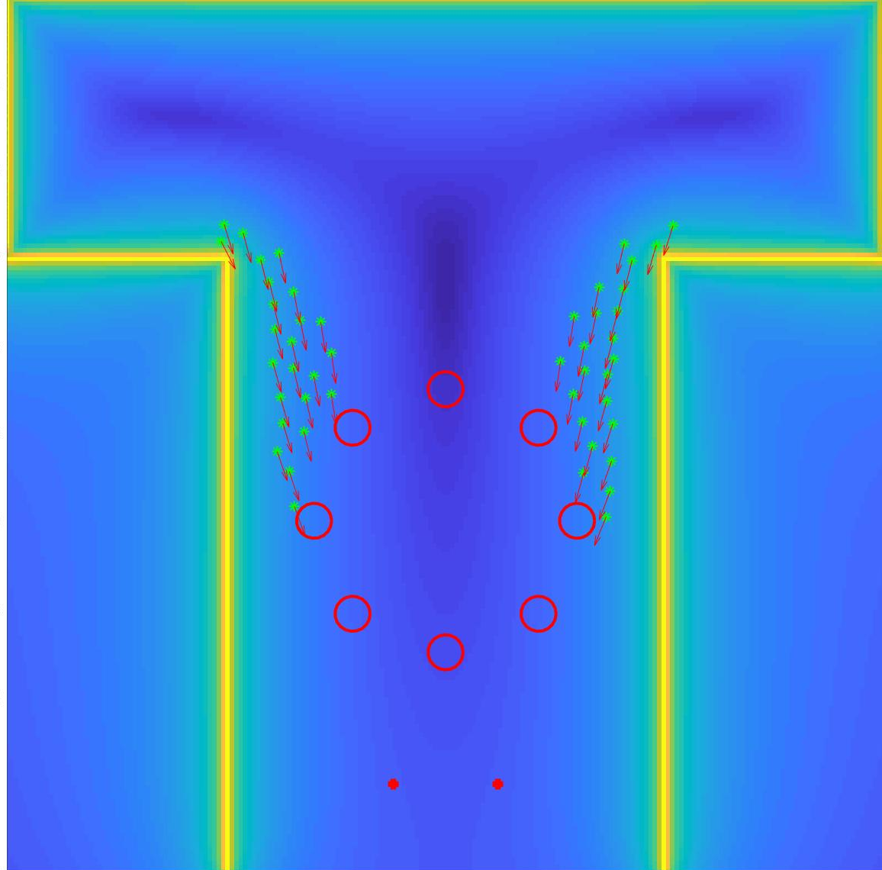
For what concerns the implementation, I’ll first explain the organization of the apero room.
As you can see from the picture, the room has a T shape. Every simulation, people are initially distributed in the two top-left and top-right corners of the room.
The buffet tables are 2, and they are at the bottom.
Once the people get some food, they move to the tables in the centre. We have analysed two table configurations, circular and rectangular.
Implementation
Initial position of tables, people and food points
Two table configurations: rectangular and circular dispositions.
The people are initially located on the top-left and top-right of the map.
The position of the tables where the food is distributed are two and they are located on the bottom of the room.
Notes:
The main objective of the research consists in explaining what was known 20 years ago about piezos,
and this is the first half of the half of the contents of the paper
and the experimental comparison with another solution that was well established, the constrained layer damping treatments
The experiment will be explained by Francesca

Slide 2
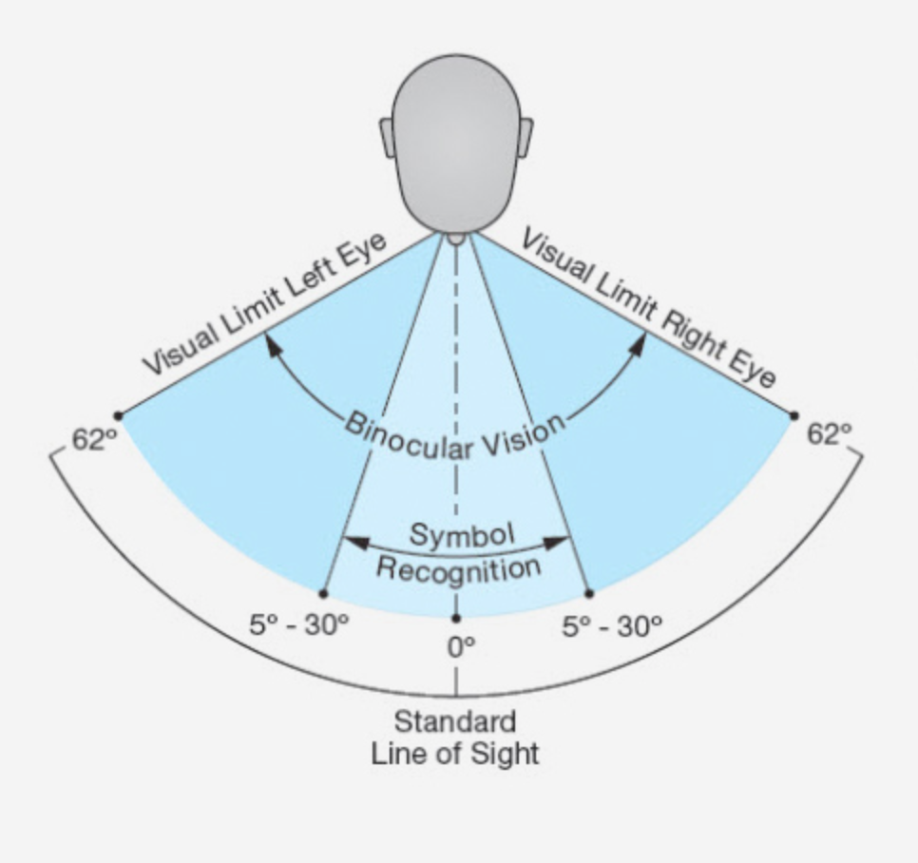



Now, coming back to the force, we explained in the social force model it was advised to use monotonically decreasing functions.
In our model, the interaction between a person and the other people is described by an exponential function. The parameters assume the same values the researcher have used in the social force model
(A=2N, B=0.1 per meter)
The visual field spans for 60 degrees. If a person is outside the visual field, for example behind him, the force drops to 30%
Implementation
Person-people repulsive force
Exponential force that decreases with the distance among pedestrians.
$A=2 N$
$B=0.1 1/m$
$φ=60°$ visual field
$${\vec{F}}_{αB}={ωAe}^{b/B}$$
$$ω\left(\vec{e}∙\vec{f}\right)=\left\{\begin{aligned}1 if \vec{e}∙\vec{f}≥\left\|\vec{f}\right\| cos⁡(φ) \\ 0.3 otherwise \end{aligned}\right.$$
Notes:
The main objective of the research consists in explaining what was known 20 years ago about piezos,
and this is the first half of the half of the contents of the paper
and the experimental comparison with another solution that was well established, the constrained layer damping treatments
The experiment will be explained by Francesca

Slide 3
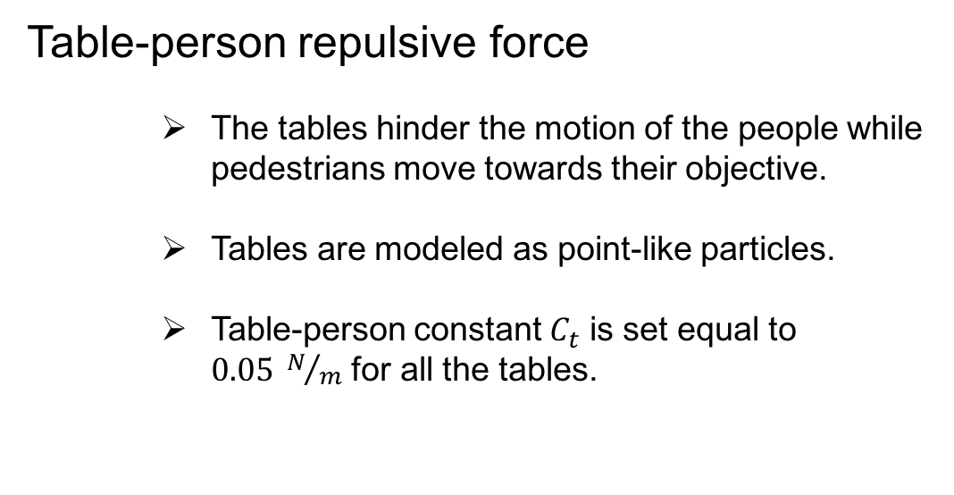
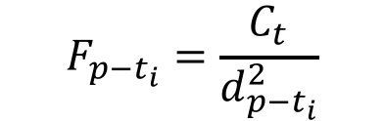

The table-person repulsive force is inversely proportional to the distance between tables and people.
Since table have a circular shape, they are modeled as point-like sources of forces.
Ct, the table-person constant, is set to 0.05 and the forces generated by the tables are superimposed.
Implementation
Table-person repulsive force
The tables hinder the motion of the people while pedestrians move towards their objective.
Tables are modeled as point-like particles.
Table-person constant $C_{t}$ is set equal to $0.05 N/m$ for all the tables.
$${\vec{F}}_{p−t}=\sum_{t_{i}=1}^{Nt}{{\vec{F}}_{p−t_{i}}}$$
$$F_{p−t_{i}}=\frac{C_{t}}{d_{p−t_{i}}^{2}}$$
Notes:
The main objective of the research consists in explaining what was known 20 years ago about piezos,
and this is the first half of the half of the contents of the paper
and the experimental comparison with another solution that was well established, the constrained layer damping treatments
The experiment will be explained by Francesca

Slide 4
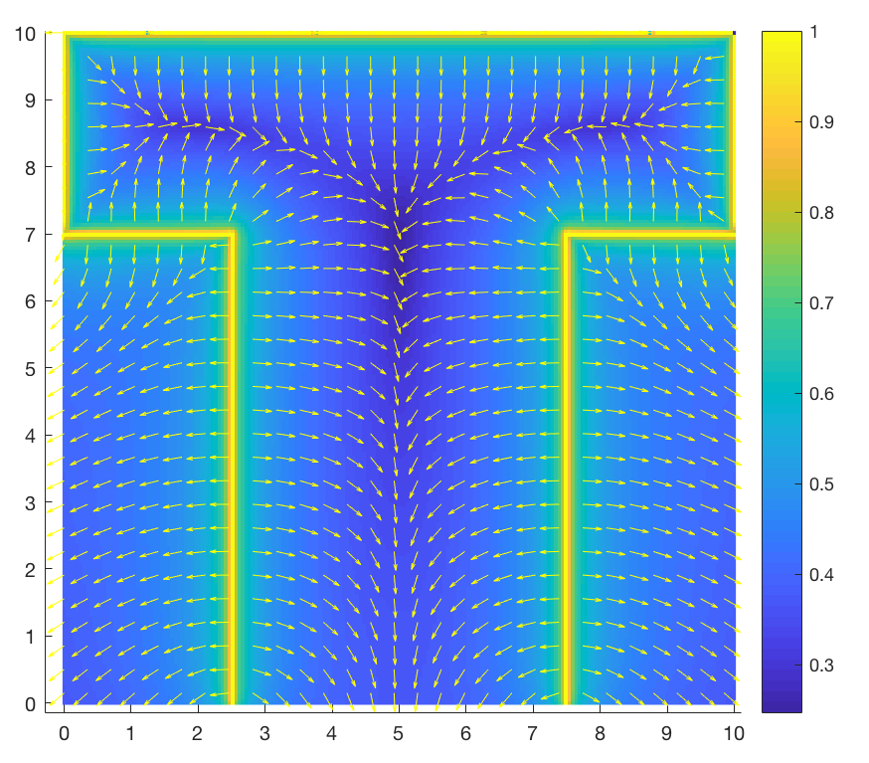
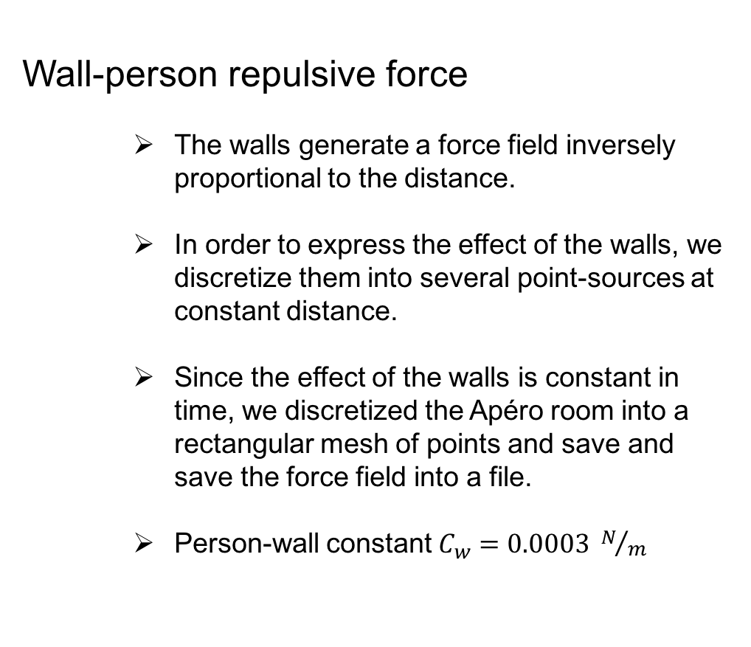


The table-person repulsive force is inversely proportional to the distance between tables and people.
Since table have a circular shape, they are modeled as point-like sources of forces.
Ct, the table-person constant, is set to 0.05 and the forces generated by the tables are superimposed.
Implementation
Wall-person repulsive force
The walls generate a force field inversely proportional to the distance.
In order to express the effect of the walls, we discretize them into several point-sources at constant distance.
Since the effect of the walls is constant in time, we discretized the Apéro room into a rectangular mesh of points and save and save the force field into a file.
Person-wall constant $C_{w}=0.0003 N/m$
Source: Pix4D
$$F_{p−w_{i}}=\frac{C_{w}}{d_{p−w_{i}}^{2}}$$
$${\vec{F}}_{p−w}=\sum_{w_{i}=1}^{Nw}{{\vec{F}}_{p−w_{i}}}$$

Slide 5
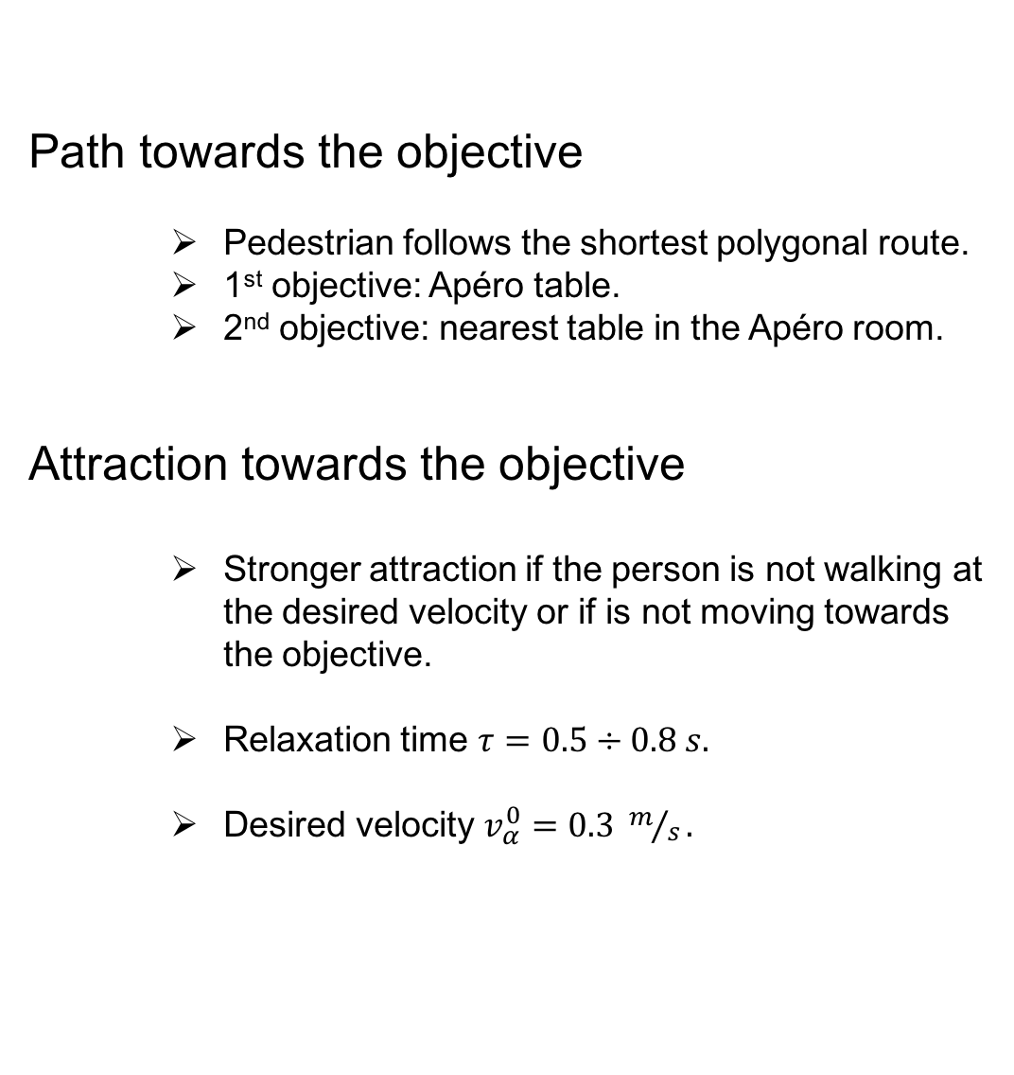
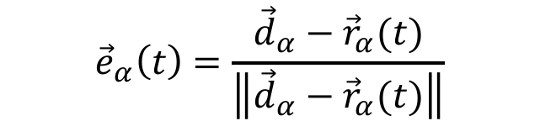
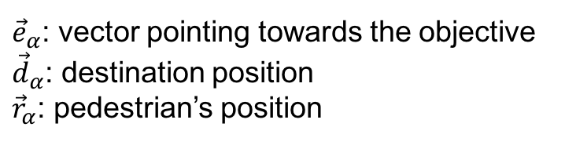
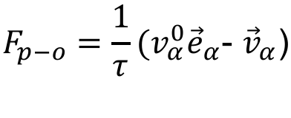

Path towards the objective
Pedestrian follows the shortest polygonal route.
1st objective: Apéro table.
2nd objective: nearest table in the Apéro room.
Attraction towards the objective
Stronger attraction if the person is not walking at the desired velocity or if is not moving towards the objective.
Relaxation time $τ=0.5÷0.8 s.$
Desired velocity $v_{α}^{0}=0.3 m/s.$
Implementation
$${\vec{e}}_{α}\left(t\right)=\frac{{\vec{d}}_{α}−{\vec{r}}_{α}(t)}{\left\|{\vec{d}}_{α}−{\vec{r}}_{α}(t)\right\|}$$
${\vec{e}}_{α}$: vector pointing towards the objective
${\vec{d}}_{α}$: destination position
${\vec{r}}_{α}$: pedestrian’s position
$$F_{p−o}=\frac{1}{τ}(v_{α}^{0}{\vec{e}}_{α}\text{- }{\vec{v}}_{α}\text{)}$$
$v_{α}^{0}$: desired velocity
$τ$: relaxation time
${\vec{v}}_{α}$: actual velocity

Slide 6
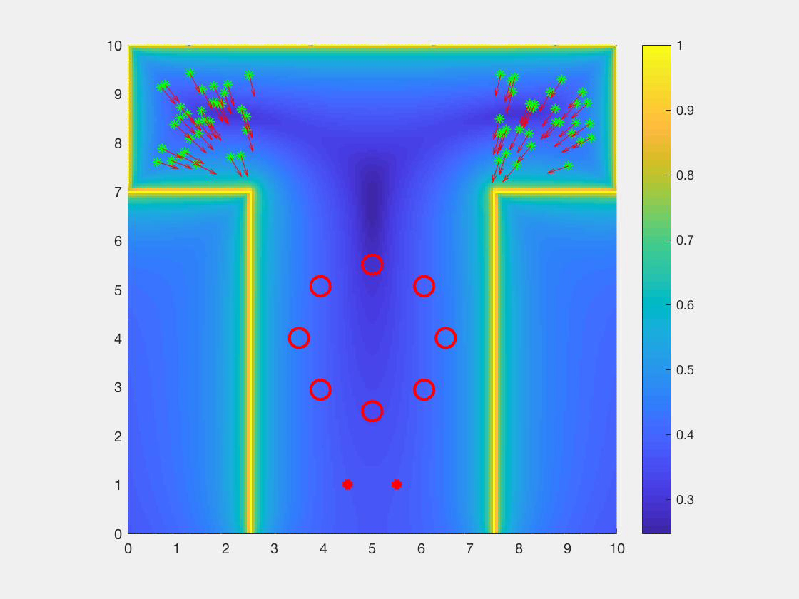
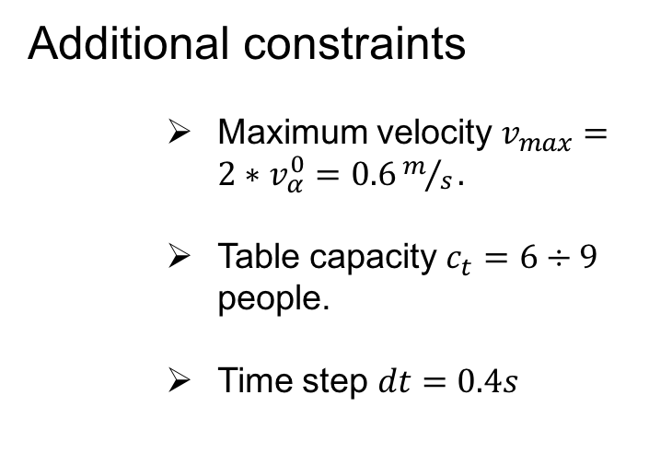
Implementation
Additional constraints
Maximum velocity $v_{max}=2∗v_{α}^{0}=0.6m/s\text{.}$
Table capacity $c_{t}=6÷9$ people.
Time step $dt=0.4s$
Source: Pix4D

